Slide 1
Supply-side Policies
3.7
Copyright Bananaomics

Slide 2
Definition
Supply-side Policies
Policies aimed at stimulating the supply of an economy by attempting to increase the quantity or quality of the Factors of Production, increase competition, and improve general efficiency of the economy.
Textbook Definition
Government policies designed to shift the long-run aggregate supply curve to the right, increasing potential output in the economy and achieving economic growth.
Copyright Bananaomics

Slide 3
The Goals of Supply-Side Policies
Copyright Bananaomics

Slide 4
The Goals of Supply-side policies
Long-term economic growth by increasing quality/quantity of Factors of Production
Improving competition
Increasing efficiency
Decreasing unemployment and cost of labor
Low and Stable Inflation
Increasing innovation by encouraging Research and Development
Copyright Bananaomics

Slide 5
Two Types of Supply-Side Policies
Market-Based (Neo-Classical)
Interventionist (Keynesian)
Designed to increase LRAS indirectly by allowing the free-market to regulate itself. (Invisible Hand)
Direct intervention by the government to imrove the quality/quantity of Factors of Production.
Copyright Bananaomics

Slide 6
Market Based Policies
Competition policies
Labour market policies
Incentive-related policies
Copyright Bananaomics

Slide 7
Policies to Increase Competition
One of the central ideas behind supply-side policies is supporting operations of the free market and increasing competition.
Policies aimed at increasing competition
Deregulation
Removing rules and restrictions so firms may behave freely
Privatization
This occurs when the government transfers ownership of a firm or industry to the private sector.
Trade Liberalisation
Removing barriers to trade with other nations to allow for free movement of imports/exports
Anti-monopoly regulation
Regulations that are designed to prevent one firm from dominating the market and reducing competition.
Copyright Bananaomics

Slide 8
Case Study
Click Me
What are the disadvantages and advantages of privatization?
Do you agree with the decisions regarding Air India?
Copyright Bananaomics

Slide 9
Labour Market Policies
The government has a role in creating a more educated, efficient, and skilled workforce. The labour market should be competitive and flexible.
Policies aimed at creating flexibility and competitiveness in the labour market
Reducing or removing unemployment benefits
This type of transfer payment could be reduced if they are high enough to discourage or disincentivize qualified or skilled individuals to pursue employment.
Removing minimum wages
Minimum wage is a type of wage floor and therefore creates inefficiency in the labour market. Removing or reducing minimum wages allows for the free market to work properly.
Discouraging or minimizing the power of labour unions
Labour unions always push for higher wages and may interfere with efficiency if workers choose to go on strike.
Copyright Bananaomics

Slide 10
Incentive-related policies
Implemented to encourage the aggregate supply to increase with a focus on capital and labour.
Increase in Labour - incentives given to individuals
Example
Personal income tax cuts
Incentivizing workers to work more hours as with tax decreases, they receive more disposable income.
Incentivizing unemployed people to find jobs faster
If this policy is in effect permanently, long-run aggregate supply (LRAS) will increase resulting in economic growth.
Challenges
Government receives minimal revenue when the tax rate is too low and workers are disincentivized to work if tax rates are too high.
If the government revenue is too low it cannot fund government spending sustainably.
Copyright Bananaomics

Slide 11
Incentive-related policies
Implemented to encourage the aggregate supply to increase with a focus on capital and labour.
Increase in Capital - incentives given to firms
Example
Cuts to business and capital gains tax (the profit a firm makes from selling an asset)
A decrease in business/corporate tax - Firms generate more profit
A decrease in capital gains tax - Incentivizes investments and improvement
Additional profit for firms leads to an increase in investment in production resulting in an increase of supply in the economy. A fall in capital gains tax incentivizes firms to improve and update their assets including properties, factories, etc.
Copyright Bananaomics

Slide 12
Interventionist Supply-Side
Policies
Copyright Bananaomics

Slide 13
Interventionist Supply-Side Policies
The previously discussed market-based supply-side policies aim to remove obstacles to free-market forces.
Interventionist Policies involve the government directly intervening in the economy to increase the quality or quantity of the factors of production.
Copyright Bananaomics

Slide 14
Interventionist Supply-Side Policies
Interventionist Policies:
Education
Improving health care
Improving infrastructure ( capital resources that facilitate economic activity typically provided by the government).
Research and Development
Industrial Policies
Copyright Bananaomics

Slide 15
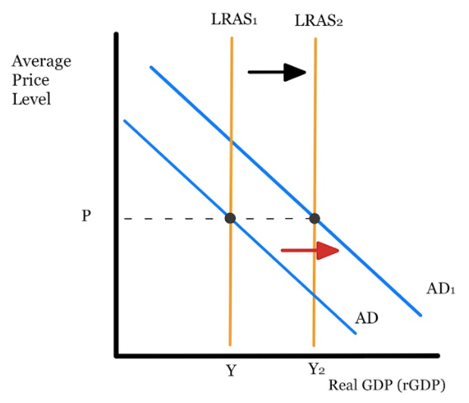
Interventionist Supply-Side Policies
Education and training
Government spending on education is designed to improve human capital which improves the quality of workers. Higher quality labour increases productivity and economic growth as the LRAS curve shifts to the right.
Healthcare
Access to high quality healthcare ensures that workers are healthy and able to be productive leading to increased efficiency.
Copyright Bananaomics

Slide 16
Interventionist Supply-Side Policies
Research and Development
Direct investment for innovation and new technology. These new innovations have the ability to increase efficiency.
Infrastructure Development
Improvements in infrastructure include the development of roads, railroads, airports, public transportation, telephone networks, electrical supply, etc. Improvements in infrastructure allow for increased general productivity and efficiency.
Industrial Policies
The targeting of development in specific industries or sectors in the economy. Most commonly, Import Substitution is used to subsidize industries to substitute productive from abroad to domestic.
Copyright Bananaomics

Slide 17
Demand-side effects of Supply-side policies
Copyright Bananaomics

Slide 18
Connections!
How do you think these supply-side policies affect demand in the economy?
Go through each supply-side policy and determine how it will affect demand.
Copyright Bananaomics

Slide 19
Demand-side effects of Supply-side policies
Economists argue that supply-side policies alone cannot lead to economic growth. In order for true efficiency or capacity to occur, there must be a corresponding increase in AD.
Luckily, supply-side policies typically have effects on AD.
SS Policies that have demand-side effects:
Industrial policies
Cutting personal income taxes
Reducing unemployment benefits
Abolishing the minimum wage
Copyright Bananaomics

Slide 20
Interventionist Supply-Side Policies
Industrial Policies
When the government chooses to support certain industries, those industries, and their linked industries must hire more workers leading to an increase in income and therefore, consumption.
Reducing Personal Income Tax
Cutting taxes increases disposable income for workers leading to higher consumption.
Copyright Bananaomics

Slide 21
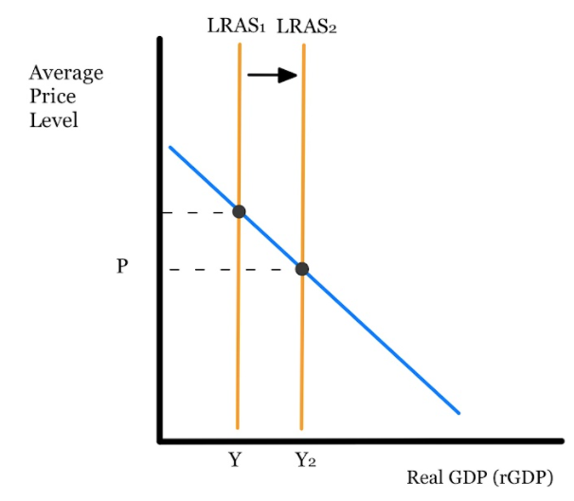
Interventionist Supply-Side Policies
Reducing Unemployment Benefits
Individuals that were relying on unemployment benefits now much cut back on excess or additional spending. This leads to a decrease in consumption.
Minimum Wage Reduction
Reducing the minimum wage results in workers receiving lower incomes leading to a decrease in consumption.
Copyright Bananaomics

Slide 22
Fiscal Policy effects on Supply-side
Copyright Bananaomics

Slide 23
Fiscal Policy Effects on Supply-Side
The use of taxes and government spending are designed to affect AD but the use of fiscal policy can have unintended consequences on the supply side.
How Fiscal Policies affect Supply-side
Increase in supply
Typically, government spending on things like infrastructure leads to an increase in AD and an increase in the potential of an economy.
Crowding out
Fiscal policies can crowd out private sectors and reduce their efficiency and productivity. This has a larger effect when the private sector has the desire to participate in a government-dominated market such as infrastructure because private sectors tend to be more innovative and competition-driven.
Copyright Bananaomics

Slide 24
Effectiveness of Supply-side policies
Copyright Bananaomics

Slide 25
Constraints on Supply-Side Policies
Market-based Policy Constrains
Equity
Policies like the reduction of unemployment benefits, minimum wage reductions, and reducing the power of labor unions all can have a detrimental effect on income equality.
Time Lags
Supply-side policies, like Fiscal Policy, require legislation passed by parliament or congress.
Vested Interests
Lobbyists have the ability to influence political decisions due to their vested interest (a government decision directly benefits a firm or industry)
Sustainability (Environmental Impact)
Freeing firms from regulations sometimes results in environmental damage.
Copyright Bananaomics

Slide 26
Constraints on Supply-Side Policies
Interventionist Policy Constraints
Costs
Supply-side policies can be quite expensive for governments resulting in an increase in the budget deficit and debt.
Time lags
Once again, government policies are constrained by the legislative process.
Copyright Bananaomics

Slide 27
Strengths of Supply-Side Policies
Market-Based Policy Strengths
Improved resource allocation
Government intervention typically results in allocative inefficiency. Removing regulation and supply-side policies
No burden on the government budget
Market-based policies typically do not negatively impact the government budget although at times, it can actual improve the budget (e.g. reduction of unemployment benefits)
Copyright Bananaomics

Slide 28
Strengths of Supply-Side Policies
Interventionist Policy Strengths
Direct support of sectors important for growth
Interventionist policies can target specific sectors for economic growth by providing resources and funds to aid their growth.
Copyright Bananaomics

Slide 29
Review Video
Tutor2U - Supply Side Economics
Copyright Bananaomics

Slide 30
Practice Question
Copyright Bananaomics

Slide 31
Paper 1
M18/3/ECONO/HP1/ENG/TZ1/XX
(b) Evaluate the view that fiscal policy is the most effective way of achieving long-term economic growth. [15]
Copyright Bananaomics

Slide 32
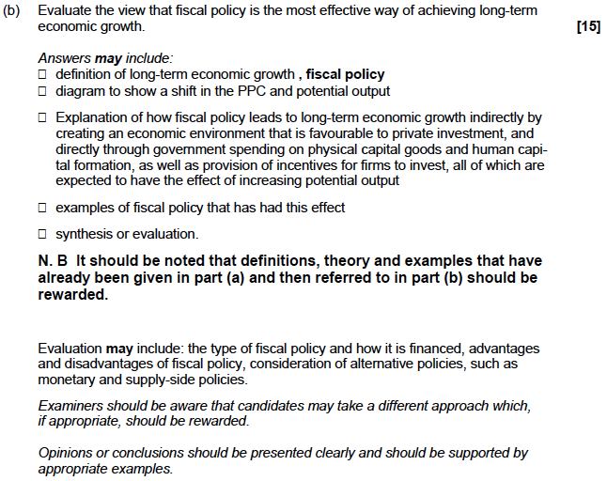
Mark Scheme
Copyright Bananaomics

Slide 33
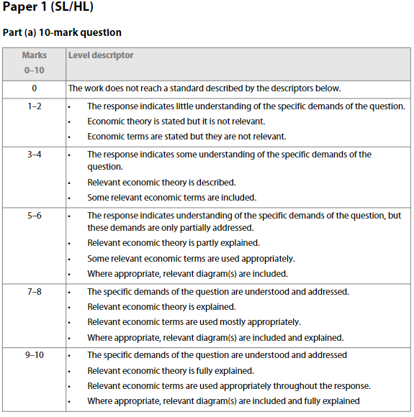
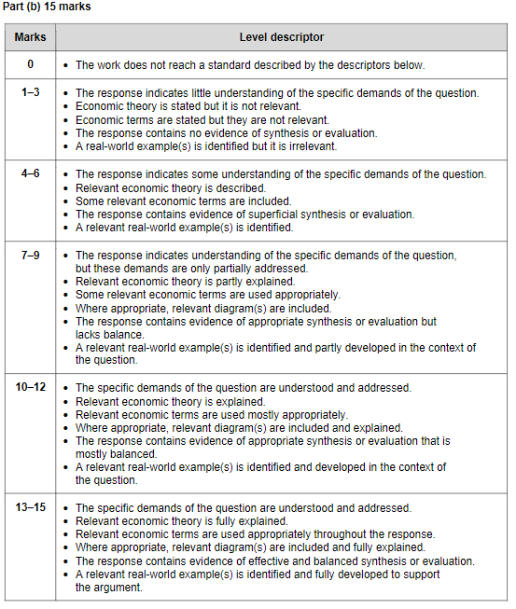
Mark Scheme
Copyright Bananaomics

Slide 34
Socratic Seminar
Demand-Side
Supply-Side
Link to Resource
Copyright Bananaomics

Slide 35
Enjoying The Content?
Visit bananaomics.com to purchase package deals with discount prices!
BANANAOMICS

